Slide 1
Exterior Derivatives / One-Forms
Howie Choset

Slide 2


Gradient and Directional Derivative
$∇f= \left[\begin{matrix}\frac{∂f}{∂x} \\ \frac{∂f}{∂y} \\ \frac{∂f}{∂z}\end{matrix}\right]=\left[\begin{matrix}\frac{∂}{∂x} \\ \frac{∂}{∂y} \\ \frac{∂}{∂z}\end{matrix}\right]f$
$∇f=$ $\left[\begin{matrix}\frac{∂}{∂x} \\ \frac{∂}{∂y} \\ \frac{∂}{∂z}\end{matrix}\right]f$
$$f:R^{m}→R$$

Slide 3
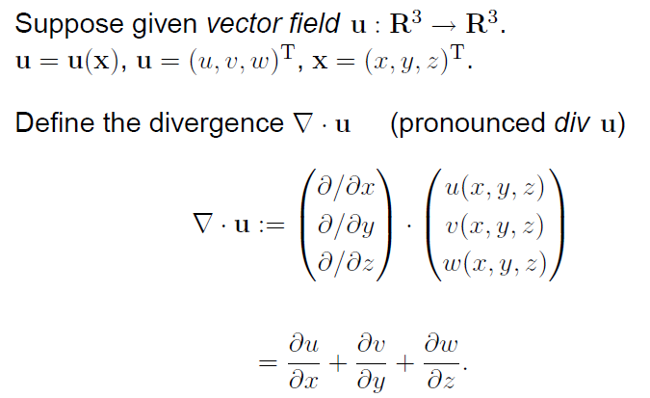
Divergence

Slide 4
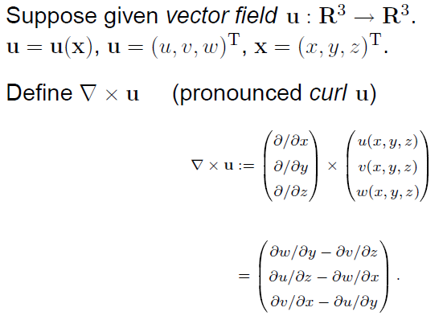
Curl

Slide 5
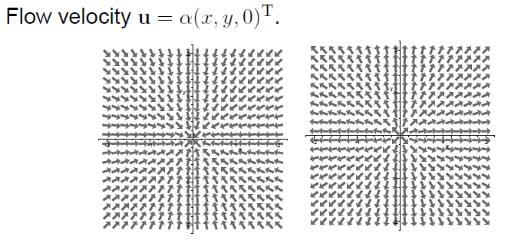
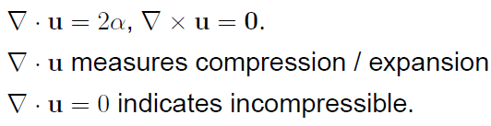
Some intuition

Slide 6
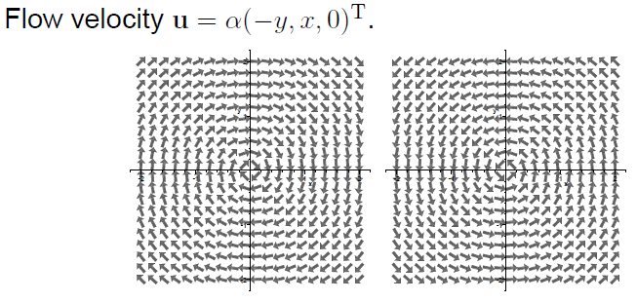
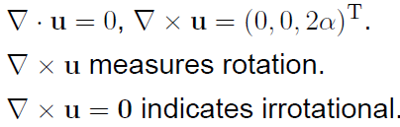
More intuition

Slide 7
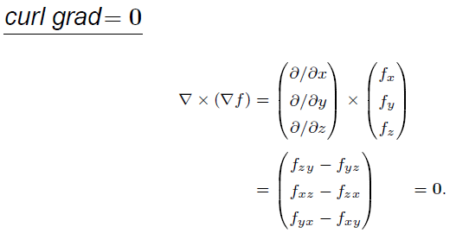
Zero Identity

Slide 8
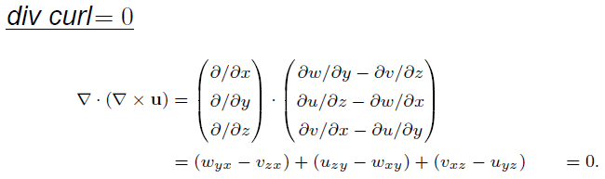
Zero Identity

Slide 9

Conservative Potentials

Slide 10
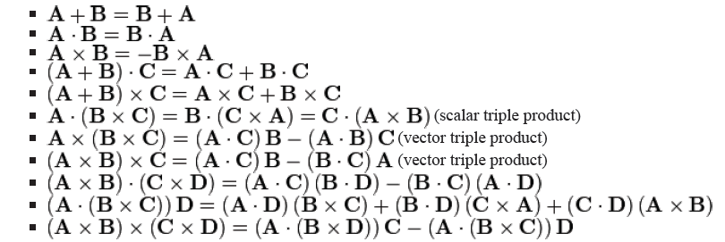



Wikipedia Has A lot of Identities

Slide 11

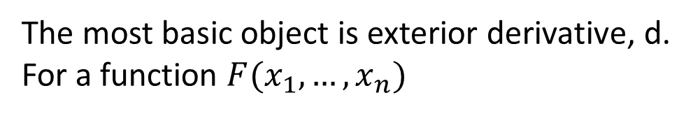
Start with Exterior Derivative
The most basic object is exterior derivative, d. For a function $F(x_{1},…, x_{n})$

Slide 12
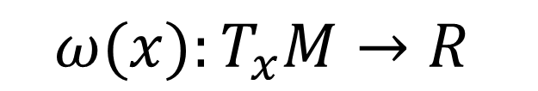
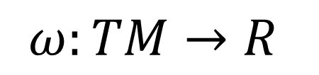


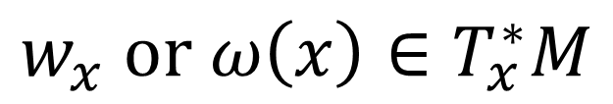
One Form and Co-vector
$$ω:TM→R$$
$$ω(x):T_{x}M→R$$
$$ω_{x}:T_{x}M→R$$
$$w_{x} or ω\left(x\right)∈T_{x}^{∗}M$$
Inner product and row vectors
One form dual to X
exterior derivative of f is the differential of f . That is, df is the unique 1-form such that for every smooth vector field X, df (X) = d_{X} f , where d_{X} f is the directional derivative of f in the direction of X.
$$w_{x }\left(v\right)=X\left(p\right) ⋅v$$

Slide 13
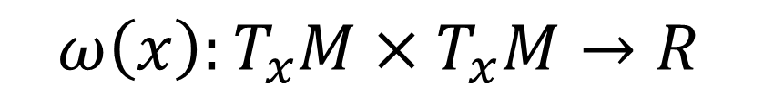
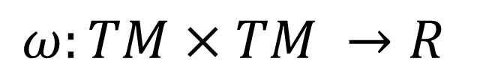
Two Form and exterior product
$$ω:TM×TM →R$$
$$ω\left(x\right):T_{x}M×T_{x}M→R$$
$$w_{1}∧w_{2}\left(v_{1},v_{2}\right)=w_{1}\left(v_{1}\right)w_{2}\left(v_{2}\right)−w_{1}\left(v_{2}\right)w_{2}(v_{1})$$

Slide 14
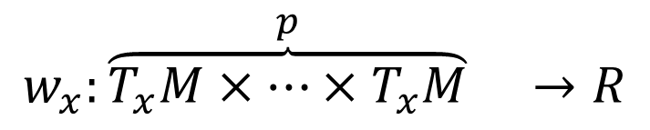
p-form and exterior derivative
$$w_{x}:{\overset{p}{\overbrace{T_{x}M×⋯×T_{x}M}}}_{} →R$$
The exterior derivative of a differential form of degree p is a differential form of degree p + 1.
If a p-form is thought of as measuring the flux through an infinitesimal p parallelepiped, then its exterior derivative can be thought of as measuring the net flux through the boundary of a (p + 1)-parallelepiped

Slide 15






Wedge Product and Basis
Anti-symmetric on $i_{1}$ through $i_{p}$
sum on $i_{1}$ through $i_{p}$, each from 1 to n
if p = 2$, then ω_{ij}=−ω_{ij}$.

Slide 16

Exterior Derivative and Product Rule

Slide 17


Double Down
$$if μ=dω, then dμ=0$$
$$d^{2}=0$$
$$if dμ=0, then μ=dω for some ω$$

Slide 18

Differential forms were invented for integration

Slide 19


Stokes Theorem

Slide 20
Gradient

Slide 21
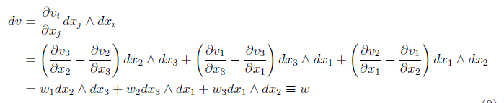
Curl
if a vector field has no curl, then it's the gradient of some function

Slide 22

Divergence
curl of a vector field has no divergence.
if a vector field is divergence free,
then it's the curl of something:

Slide 23



Stokes, Divergence Theorem
Volume integral of divergence – sources/sinks
If a fluid is flowing in some area, then the rate at which fluid flows out of a certain region within that area can be calculated by adding up the sources inside the region and subtracting the sinks. The fluid flow is represented by a vector field, and the vector field's divergence at a given point describes the strength of the source or sink there. So, integrating the field's divergence over the interior of the region should equal the integral of the vector field over the region's boundary.

Slide 24
Properties Reviewed
The exterior derivative is defined to be the unique R-linear mapping from k-forms to (k + 1)-forms satisfying the following properties:
1. df is the differential of f for smooth functions f .
2. d(df ) = 0 for any smooth function f . d(dα) = 0 for any k-form α; more succinctly, d² = 0
3. d(α ∧ β) = dα ∧ β + (−1)^{p} (α ∧ dβ) where α is a p-form. That is to say, d is an antiderivation of degree 1 on theexterior algebra of differential forms.
Pullback

